Slide 1
Being a Christian in the Workplace - without appearing weird!
Michael Coveney
Transform Work UK

Slide 2
Beware …
Notes:
Link to Video

Slide 3
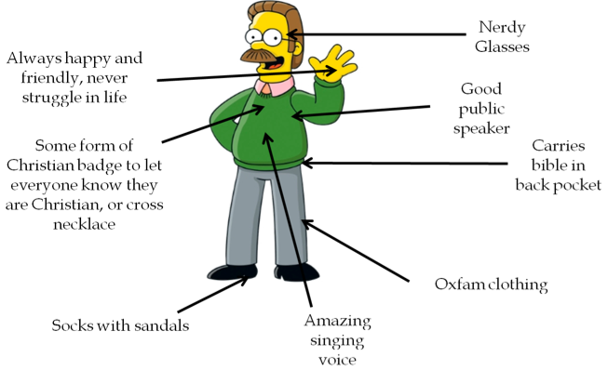
Christian Stereotype 1

Slide 4
Christian Stereotype 2

Slide 5
Christian Stereotype 3

Slide 6
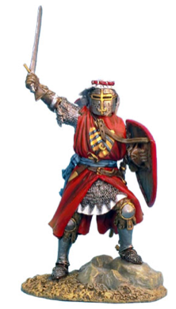
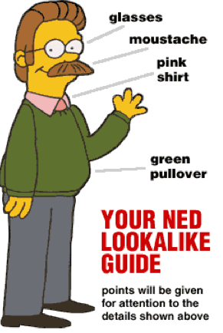
The Workplace Challenge:
How can a Christian live out their faith at work without being “weird”?
“If the Christian faith is not relevant in the workplace, then it is not relevant at all.” Ken Costa

Slide 7
Workplace Ethics: The example of Daniel
Out of his comfort zone:
Forced into a foreign land, language, customs
Sought God for his role in the workplace
Uncomfortable with the clash between faith and the workplace practices
Met and prayed with with friends
Strived to be the best they could be to support the organisation
Prayed for their employer
When issues arose they prayed and stepped out in faith
They were trusted employees
Never complained
Only wanted the best for their employer
Notes:
Daniel 1:
Taken to a foreign land, forced to learn new language and customs
Had their names changed
Placecof work kings palace
Education to last 3 years
Daniel was uncomfortable about the clash between his faith and the way of the foreigners in regard to the food they were given, but rather than complain they engaged with management and found a way that was better for his manager, the king and the organisation.
It wasn't an ultimatum - but asked manager to test the approach.
They excelled at their work - and were 10x better than anyone else in their organisation. That skill came from God who they put first.
Daniel 2:
The boss (king) - the enemy... - has a problem. Daniel gets together with his friends to pray about it. God gives them the answer and because of their previous reputation in how they conducted themselves at work their immediate manager Arioch, he was willing to recommend they see the king with the solution.
This would never have happened if they had kept quiet or taken a stance that complained about their unfair situation - which would be quite right. But they saw the bigger picture. Their workplace was a place they had been appointed by almighty God - and the same is true of our workplace situations.
So what lessons can we learn from Daniel and how can we apply them to our modern day workplace?

Slide 8
7 Steps to Transforming the Workplace
Recognise that your workplace is your mission field
It’s the place where God has appointed you to be His ambassador

Slide 9
7 Steps to Transforming the Workplace
Recognise that your workplace is your mission field
Make contact with other Christians where you work
Wear a ‘Christian’ symbol
Use a cup with a Christian message
Put a note on the notice board
Look out for people doing the same

Slide 10
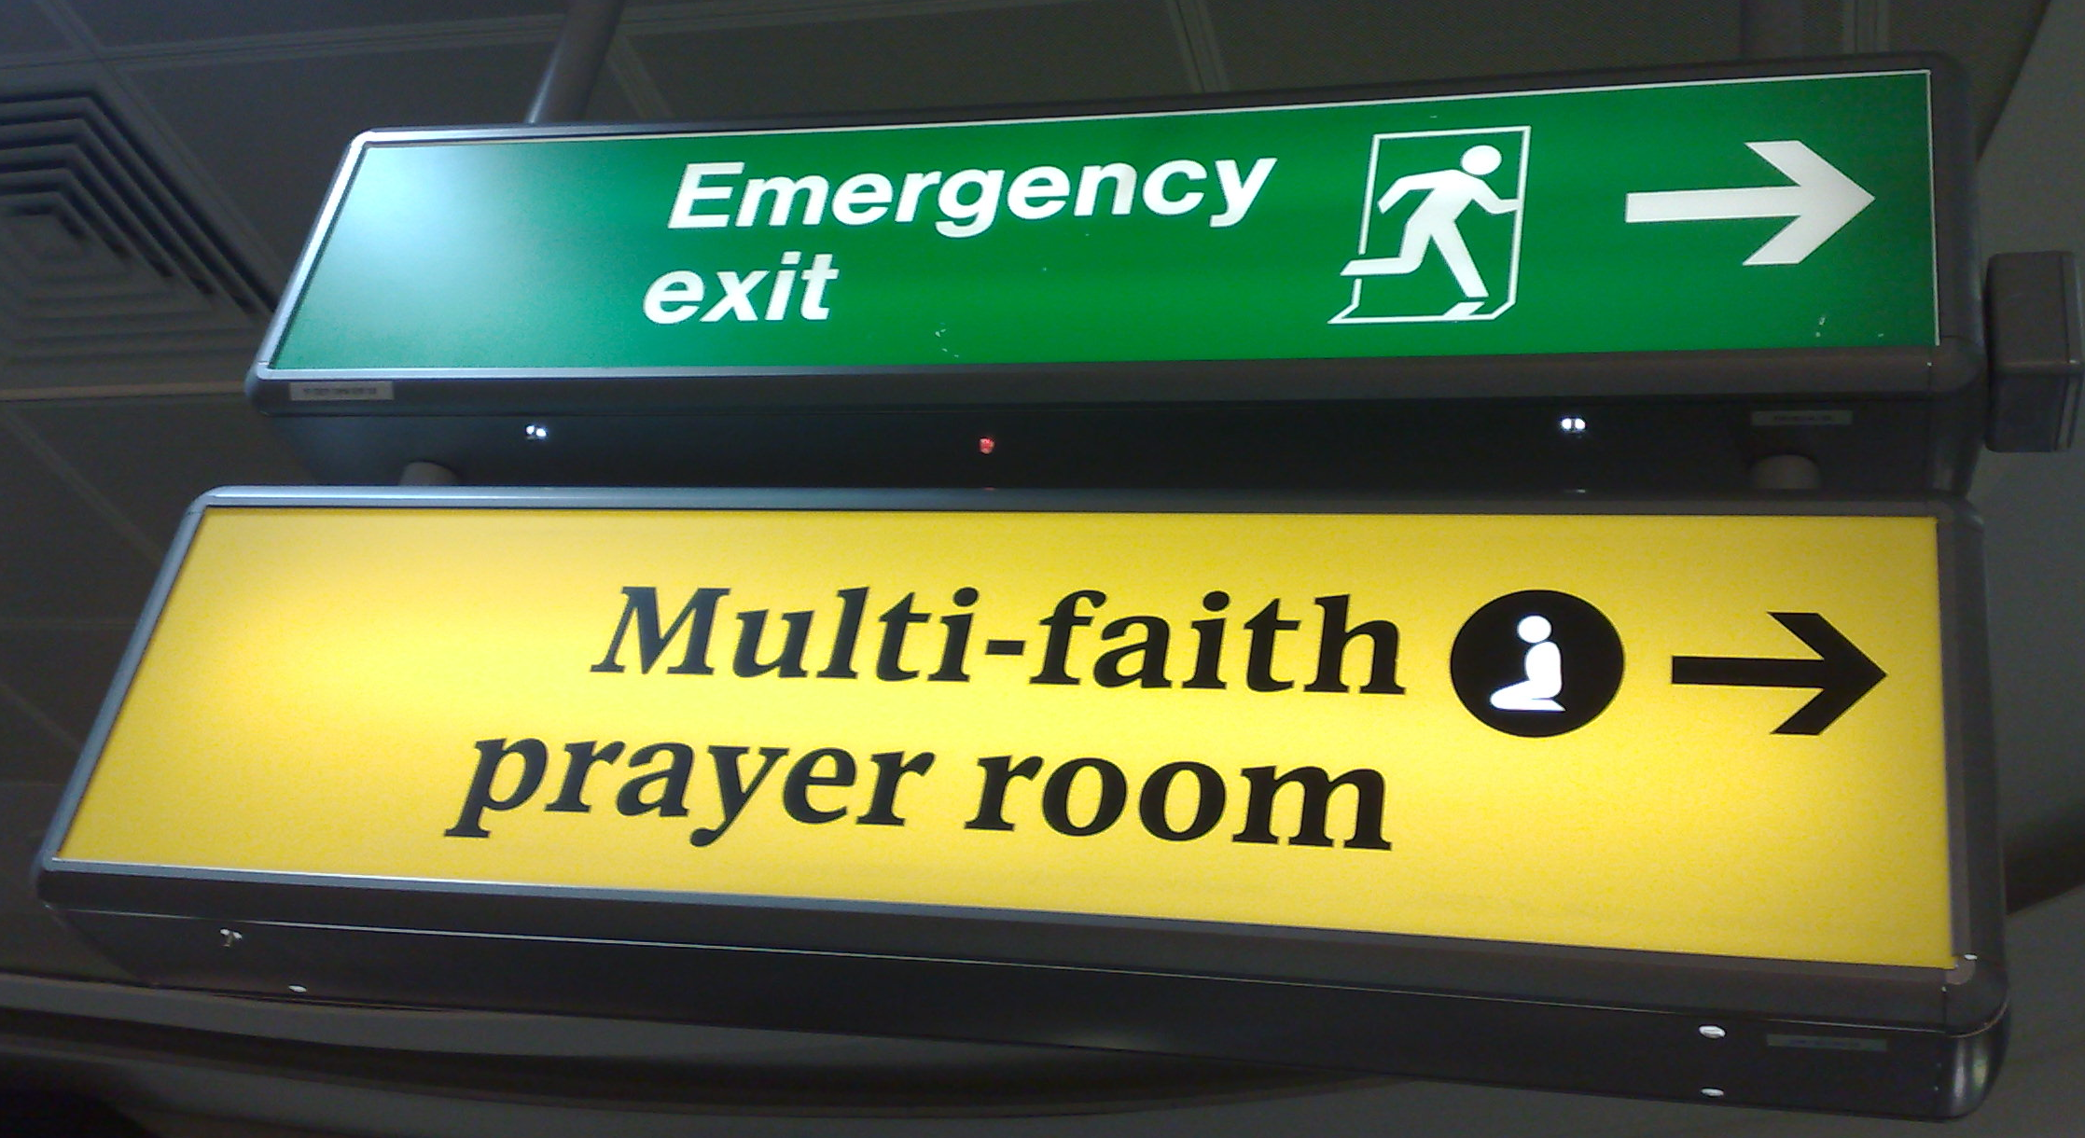
7 Steps to Transforming the Workplace
Recognise that your workplace is your mission field
Make contact with other Christians where you work
Meet and pray regularly for your organisation.
Does the organisation have a prayer room?
Is there a multi- faith forum
At the same time be the best employees you can be . Remember your work should be as unto Jesus

Slide 11
7 Steps to Transforming the Workplace
Recognise that your workplace is your mission field
Make contact with other Christians where you work
Meet and pray regularly for your organisation.
Get your group recognised as a staff network
Build a business case for being a staff network
Use our booklet ‘Starting a Christian Workplace Group’
Being a staff network gives you permission to advise the organisation. Let them know that your purpose is to bless/help/support them.

Slide 12
7 Steps to Transforming the Workplace
Recognise that your workplace is your mission field
Make contact with other Christians where you work
Meet and pray regularly for your organisation.
Get your group recognised as a staff network
Identify areas where your group could impact the workplace for the good of stakeholders.
This is not about you standing up for your rights, no matter how right you may be. It's about others.
Support the organisations adopted charity or choose one such as Christian Aid

Slide 13
7 Steps to Transforming the Workplace
Recognise that your workplace is your mission field
Make contact with other Christians where you work
Meet and pray regularly for your organisation.
Get your group recognised as a staff network
Identify areas where your group could impact the workplace for the good of stakeholders.
Celebrate your success. Let people know what you are doing and invite others to join you.
Celebrate major Christian festivals – Easter, Christmas
Be open – not exclusive. It’s not our place to judge but to love
Don’t ‘Bible bash’ - remember that its when asks us ‘why’ we can then give an answer to glorify God for what he has done for us

Slide 14
7 Steps to Transforming the Workplace
Recognise that your workplace is your mission field
Make contact with other Christians where you work
Meet and pray regularly for your organisation.
Get your group recognised as a staff network
Identify areas where your group could impact the workplace for the good of stakeholders.
Celebrate your success. Let people know what you are doing and invite others to join you.
Engage with senior management over serious issues confronting the business.
Even if it is just to pray for them. Ask them what the problem is and then pray for the answer

Slide 15
7 Steps to Transforming the Workplace
The Key to being an effective witness:
So you must continue to live in a way that gives meaning to your salvation. Do this with fear and respect for God. Yes, it is God who is working in you. He helps you want to do what pleases him, and He gives you the power to do it. Philippians 2:12-13

Slide 16
At what stage are you?
Recognise that your workplace is your mission field
Make contact with other Christians where you work
Meet and pray regularly for your organisation.
Get your group recognised as a staff network
Identify areas where your group could impact the workplace for the good of stakeholders.
Celebrate your success. Let people know what you are doing and invite others to join you.
Engage with senior management over serious issues confronting the business.

Slide 17
And don’t forget …
Daniel transformed not only transformed his workplace - but the nation as well!
We are here to help you – you are not alone!

